Slide 1


Fraud Detection in the Sports Betting Industry

Slide 2


Project Leadership
Sharat Manikonda
Director at Innodatatics and Sponsor
linkedin.com/in/sharat-chandra
Bharat Kumar
Project Mentor
https://www.linkedin.com/in/kumarbharathk/

Slide 3

Team Members
Name: Pankaj Kumar Kori
https://www.linkedin.com/in/pankaj-kori-36691319a
Github:https://github.com/KoriPankaj/OnlineBetFraud

Slide 4

Contents
Project overview & Scope
Project Goals
CRISP-ML(Q)
Objectives and Constraints
Technical Stacks
Project Architecture
Data Collection and Data Understanding
Model Building & Tuning
Deployment
Conclusion
Notes:
Change

Slide 5
Project Overview and Scope
Overview:
The global sports betting market was valued at USD 70.23 billion in 2021 and is expected to grow at a CAGR of 11.7% during the forecast period up to 2030.
The football segment is expected to highest CAGR during the forecast period as the popularity of this game.
Collecting data from http://www.thetransparencyproject.org/
Applying D-Tale library for Auto EDA
Predicting the fraud cases using TPOT library for Auto ML
Deployment using Streamlit on Heroku Platform
Scope:
This Project deals with building a Machine Learning model in order to predict the fraudulent and suspicious transactions. Different used cases for fraudulent activities are also taken into account.

Slide 6
Project Goals
Objectives
Maximize: detection of fraud transactions in online betting platforms so companies take some preventive steps.
Minimize: the loss occur through Fraud cases.
Constraints
Ambiguous behavior of customers make fraud patterns difficult to detect.

Slide 7
CRISP-ML(Q) Methodology
Business & Data Understanding
Data Engineering (Data Preparation)
Model Building
Model Testing & Model Evaluation
Monitoring & Maintenance
Deployment
DATA
CRISP –ML(Q)
Methodology

Slide 8







Technical Stacks
CSV: A comma-separated values file, which allows data to be saved in a tabular format with a .csv extension.
Spyder: Open-source IDEs which include advanced editing, code analytical tools, IPython console, variable explorer, plots and help icon.
Git: A Git repository hosting service which provides a Web-based graphical interface.
Streamlit: Used to build the interactive dashboard and machine learning web app without any front-end web development (html file).
Heroku: Used to deploy web application.
Microsoft Azure: Infrastructure as a service (Iaas) used for cloud deployment of machine learning model.
Notes:
Pycharm add Tableau

Slide 9
Project Architecture
Data Preparation
Project Objective
Project Objective
Data Understanding
Auto-EDA
(DTALE)
Data Pre-processing
Data Collection
Model Building
Model evaluation
Auto-ML
(TPOT)
Model Selection
Model Deployment
Web Application
Streamlit
Cloud Deployment
Heroku

Slide 10
Data Collection and Understanding
Data has been collected through secondary data source.
Dataset contains 24 features and 2400 records in raw format
Some features are included based on business research.
Dataset comprises 6 used cases for fraudulent activities.

Slide 11
Data Information
Sr.No. | Feature | Description
1 | User ID | User ID was assigned to each participant by at time of registration.
2 | First Deposit Date | First deposit date
3 | Registration date | registration date
4 | inactive days | Initial Idle Days (FDD-RD)
5 | Country Name | Country of residence
6 | Gender | Gender
7 | Year of Birth | Year of Birth
8 | age at registration | Age at registration
9 | KYC Status | KYC Status( [Yes/No/Rejected])
10 | sum stakes fixed odds | Sum of stakes: fixed odds
11 | sum bets fixedodds | Sum of bets: fixed odds
12 | bettingdays fixedodds | Sum of active betting days: fixed odds
13 | duration fixedodds | Duration of betting days: fixed odds
14 | frequency fixedodds MN | Frequency fixed odds
15 | bets per day fixed odds LM | Bets per day fixed odds
16 | euros per bet fixedodds KL | Euros per bet fixed odds
17 | net loss fixedodds | Net loss fixedodds
18 | mode of payment | mode of payment (Digital wallet/ Credit card/ Debit card/ Net Banking)
19 | bonus type | Type of bonus with which customer logged in (sign up bonus / referal bonus)
20 | Ref ID | ID number from which customer receives activation link
21 | bonus amount | Amount which transfered into customer account based on bonus type.
22 | wallet amount | amount of the transaction in local currency
23 | self exclusive status | blacklisted status from website
24 | is Fraud | identifies a fraudulent transaction (1) and non fraudulent (0)

Slide 12
Data Dictionary
Sr.No. | Feature | Data Type | Sub Category of Data Type
1 | User ID | Discrete | Nominal
2 | First Deposit Date | Discrete | Interval
3 | Registration date | Discrete | Interval
4 | inactive days | Discrete | Ratio
5 | Country Name | Discrete | Nominal
6 | Gender | Discrete | Nominal
7 | Year of Birth | Discrete | Interval
8 | age at registration | Discrete | Ratio
9 | KYC Status | Discrete | Ordinal
10 | sum stakes fixedodds | Continuous | Ratio
11 | sum bets fixed odds | Continuous | Ratio
12 | bettingdays fixedodds | Continuous | Ratio
13 | duration fixedodds | Continuous | Ratio
14 | frequency fixedodds MN | Continuous | Ratio
15 | bets per day fixedodds LM | Continuous | Ratio
16 | euros per bet fixedodds KL | Continuous | Ratio
17 | net loss fixed odds | Continuous | Ratio
18 | mode of payment | Discrete | Ordinal
19 | bonus type | Discrete | Ordinal
20 | Ref_ID | Discrete | Nominal
21 | bonus amount | Discrete | Ratio
22 | wallet amount | Discrete | Ratio
23 | self exclusive status | Discrete | Nominal
24 | is Fraud | Discrete | Nominal

Slide 13
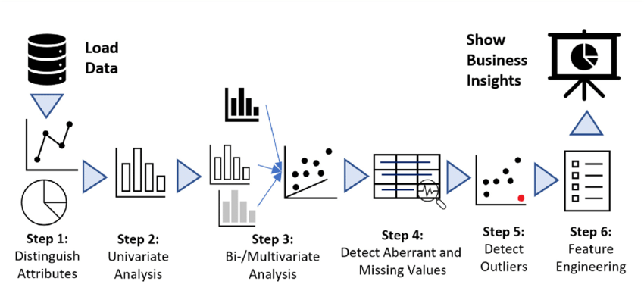
Exploratory Data Analysis [EDA]
Notes:
EDA is used for seeing what the data can tell us before the modeling task.
Change

Slide 14
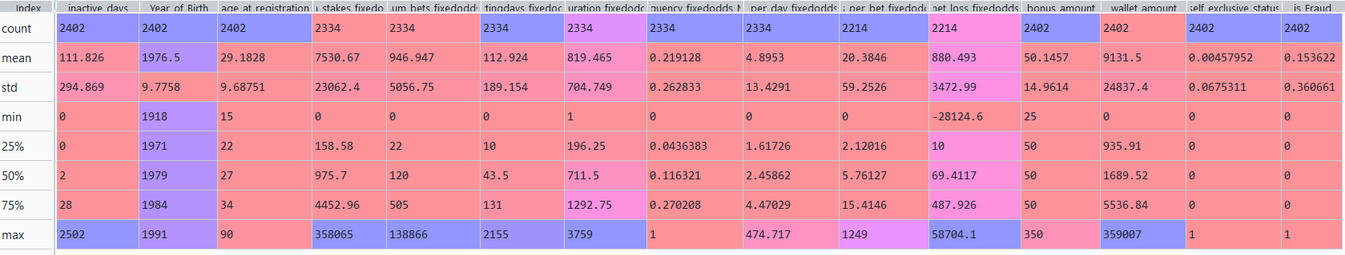
EDA Description

Slide 15
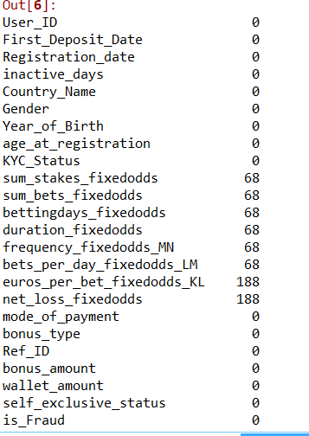
Missing Values Observation
Missing Values

Slide 16
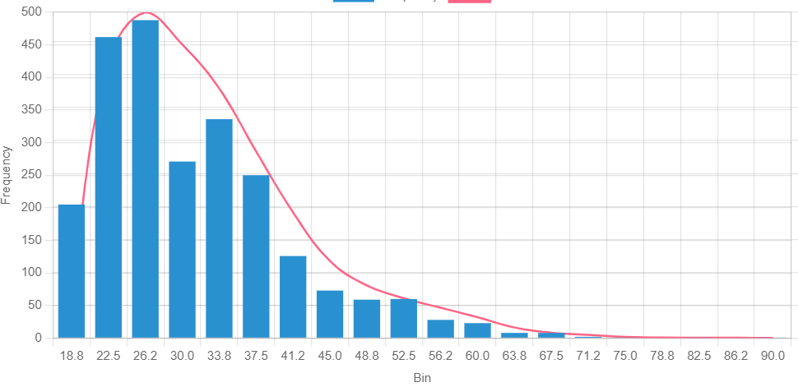
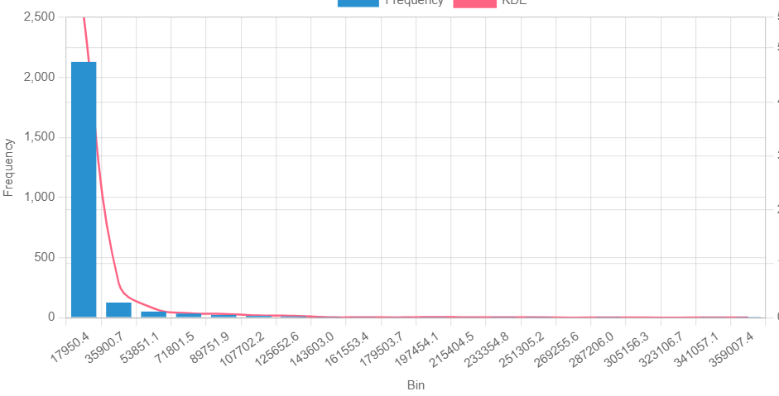
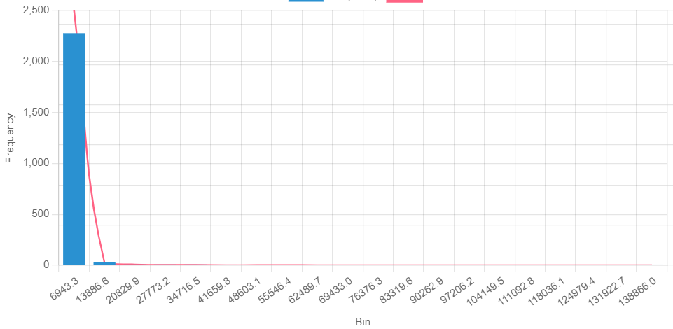
Data Visualization (Univariate Analysis: Histogram)
Age at registration
Sum of stakes Fixed odds
Sum of bets fixed odds
Notes:
Keep observations

Slide 17
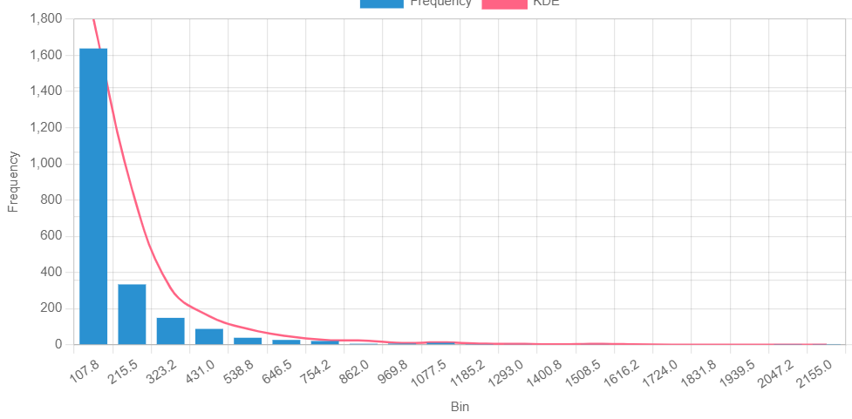
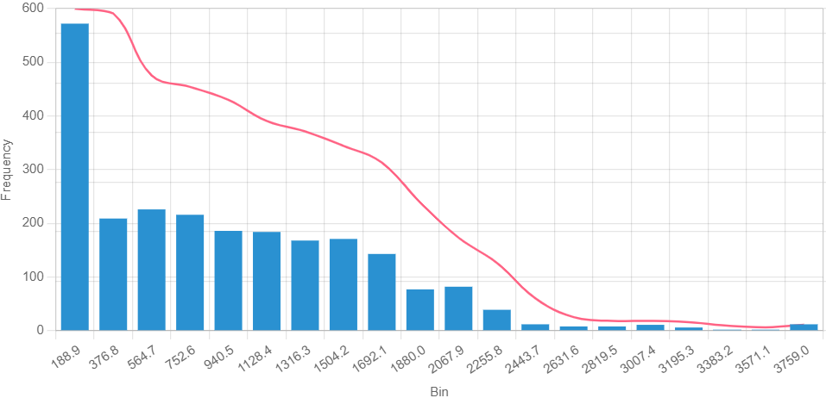
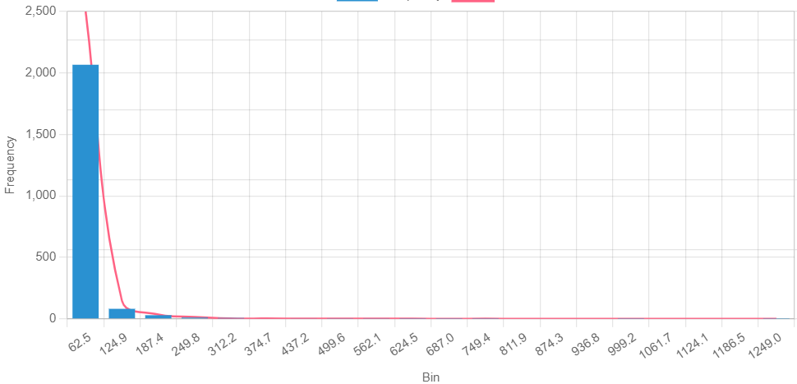
Data Visualization (Univariate Analysis: Histogram)
Betting days fixed odds
Duration Fixed odds
Bets_per_day_fixed odds
Notes:
Add graphical

Slide 18
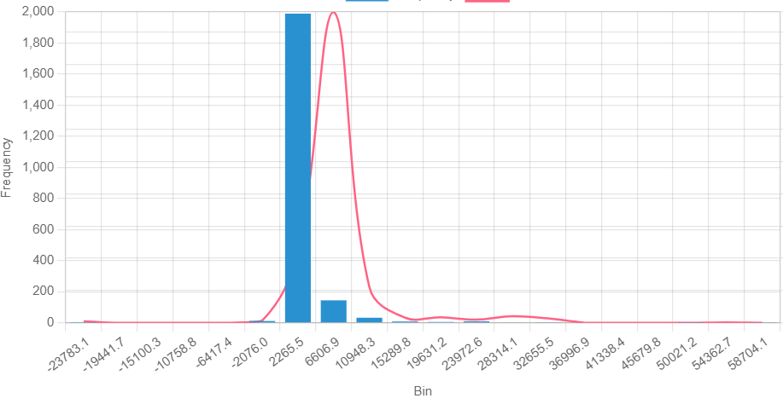
Data Visualization
Euros_per_bet_fixedodds
Net_loss_fixedodds
Notes:
Piee

Slide 19
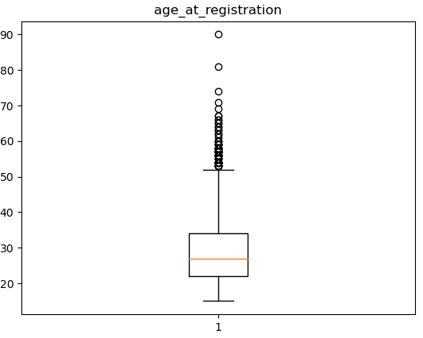
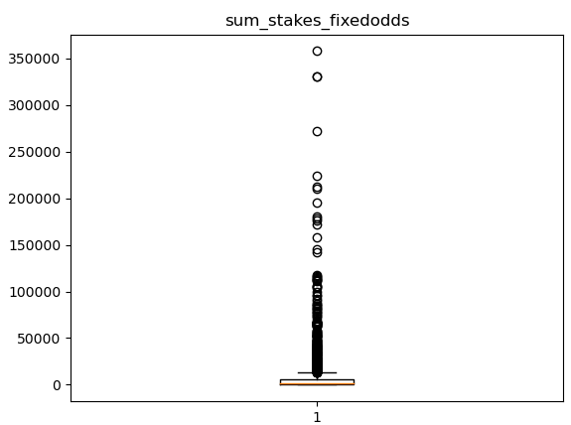
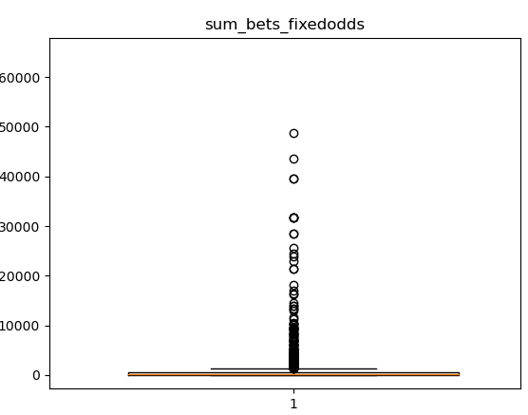
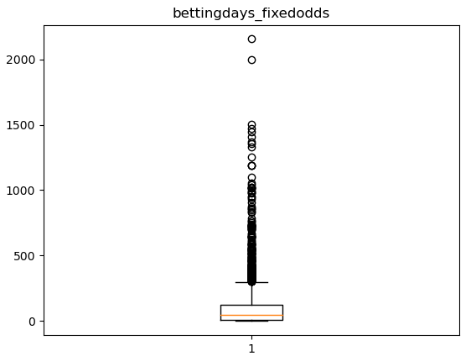
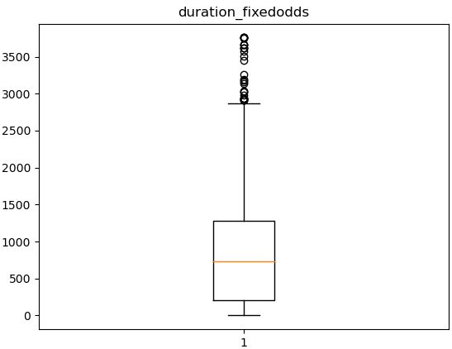
Data Visualization (Univariate Analysis: Boxplot)
Notes:
Piee

Slide 20
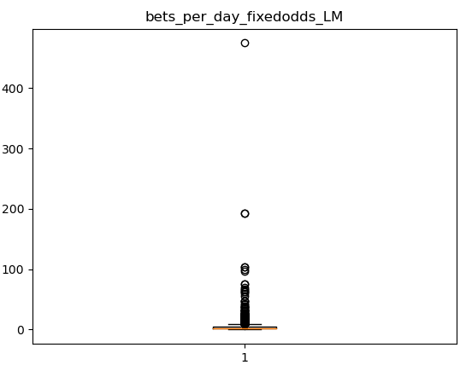
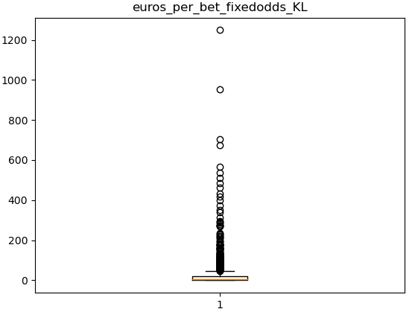
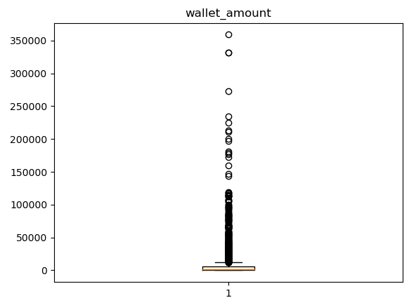
Data Visualization (Univariate Analysis: Boxplot)
Notes:
Piee

Slide 21
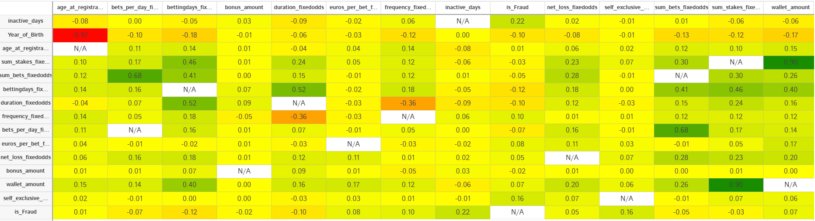
Data Visualization (Correlation Matrix)
Notes:
Piee

Slide 22
Model Building
Supervised Learning
Predictive Modelling
Classification Models
(Binary Classification)
Split Data
Training = 80% ; Testing = 20%
Auto-ML
(TPOT)
Best Pipeline
Notes:
classification is the task of predicting a discrete class label. Regression is the task of predicting a continuous quantity.
What is classification techniques in machine learning?
The Classification algorithm is a Supervised Learning technique that is used to identify the category of new observations on the basis of training data. In Classification, a program learns from the given dataset or observations and then classifies new observation into several classes or groups.
What is regression techniques in machine learning?
Regression is a technique for investigating the relationship between independent variables or features and a dependent variable or outcome. It's used as a method for predictive modeling in machine learning, in which an algorithm is used to predict continuous outcomes.

Slide 23
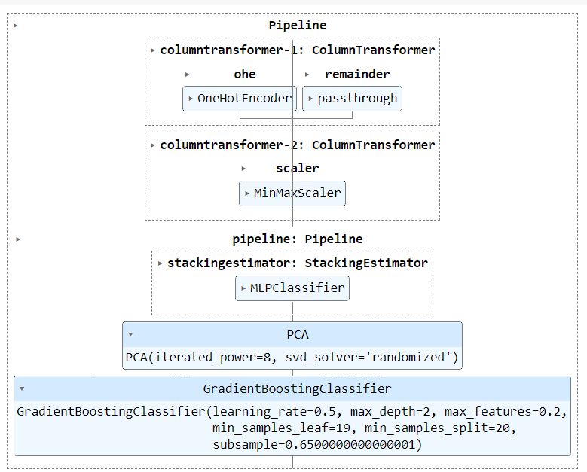
Model Building –
Notes:
What is the role of regression in ML
Is regression supervised or unsupervised?

Slide 24
Model Evaluation –
Confusion Matrix;
Predicted Class
Model Accuracy: 95.01 %
0
1
400
15
9
57
0
Actual Class
1
Classification Report;
Target (is_Fraud) | precision | recall | F1-score | support
Ok (0) | 0.98 | 0.96 | 0.97 | 415
Fraud (1) | 0.79 | 0.86 | 0.83 | 66

Slide 25



Model Deployment - Heroku
Build a python based Web Application using Streamlit.
Make git hub account and create a repository
Upload all the required files in repository for the Continuous Integration/ Continuous Deployment(CI/CD) in a cloud
Deployment Files:
1.) Procfile: It tells Heroku from which file it needs to execute a program.
2.) setup.sh file: script program for bash helps us to execute code for installation in requirements.txt.
3.) requirements.txt: contains python packages required to run python code app.py
4.) app.py: file contains the streamlit environment with the machine learning model in pickle format.
5.) pickle file: saved a machine learning model in this file.
Built ML Model
Built Front-end web app
Host repository / Source code
https://onlinefraud.herokuapp.com/
PaaS to host web endpoint

Slide 26
Model Deployment – Microsoft Azure
Build a python based Web Application using Streamlit.
Make GitHub account and create a repository (OnlineBetFraud).
Upload all the required files in repository for the Continuous Integration/ Continuous Deployment(CI/CD) in a cloud
Deployment Files:
1.) requirements.txt: contains python packages required to run python code app.py.
2.) app.py: file contains the streamlit environment with the machine learning model in pickle format.
3.) pickle file: saved a machine learning model in this file.
Connect Azure app service to GitHub repository main account.
Built ML Model
Built Front-end web app
Host repository / Source code
https://soccerfraud.azurewebsites.net/
PaaS to host web endpoint

Slide 27
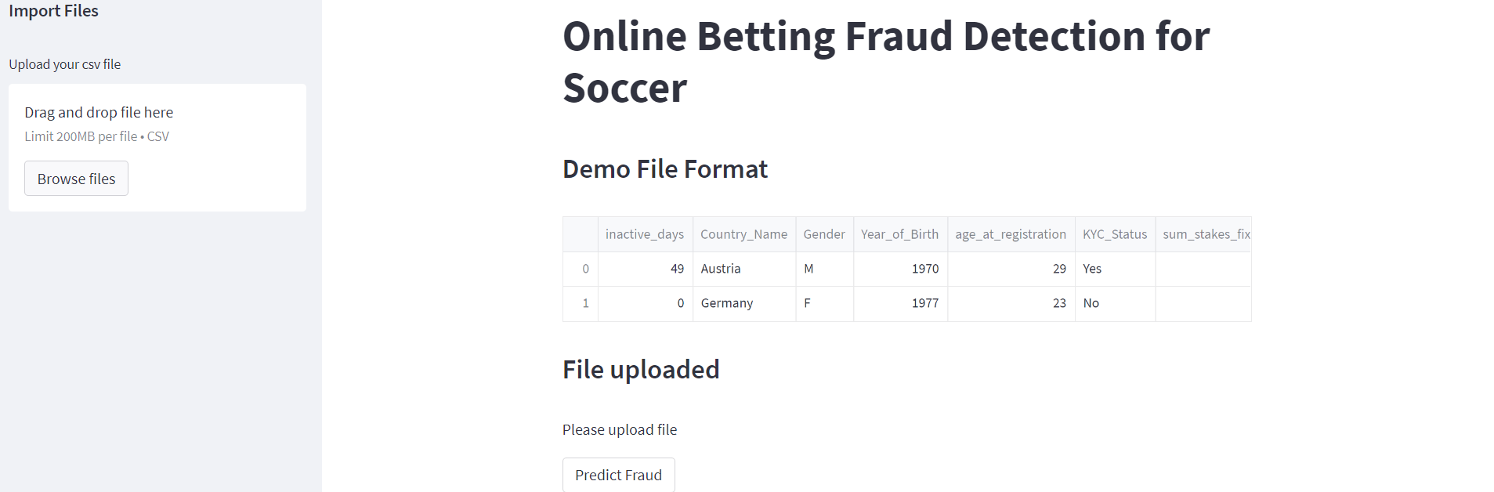
Screen shot of output

Slide 28
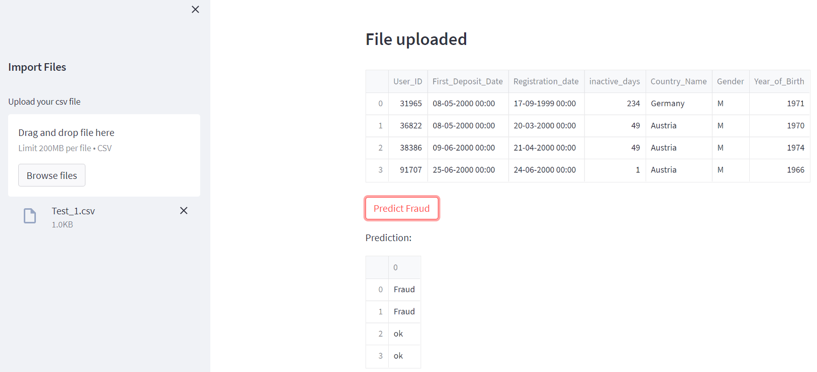
Screen shot of output

Slide 29
Challenges
Imbalanced Dataset.
Non-normal distribution of features.
Continuous availability of data.
Rectify normal and abnormal behaviour of customers.
Data quality and security.

Slide 30
Future Scopes
Multivariate Analysis.
Deployment on cloud with continuous training feature so the model perform better predictions.
Smartphone application.

Slide 31

Queries ?

Slide 32


